Slide 1
SentinelX
AI-Assisted Security Monitoring & Incident Response Platform
SOC • Threat Detection • ML Anomaly Detection • Incident Response
Project Presentation

Slide 2
1. Problem Statement
Organizations generate a large number of security events.
Manual monitoring can miss suspicious activity.
Different events may belong to the same attack or incident.
Analysts need a quick way to prioritize high-risk threats.
Investigations, alerts, and evidence need to be tracked centrally.
Challenge
Too many events, limited analyst attention.
Need
Automated detection and risk-based prioritization.
Goal
A centralized SOC-style security platform.

Slide 3
2. Proposed Solution
SentinelX centralizes security event monitoring.
Rule-based detection identifies known suspicious behavior.
Threat intelligence checks known indicators of compromise.
Risk scoring prioritizes threats from low to critical.
ML anomaly detection finds unusual events beyond fixed rules.
Incidents, alerts, investigation, MITRE mapping, reports, and audit logs are connected.

Slide 4
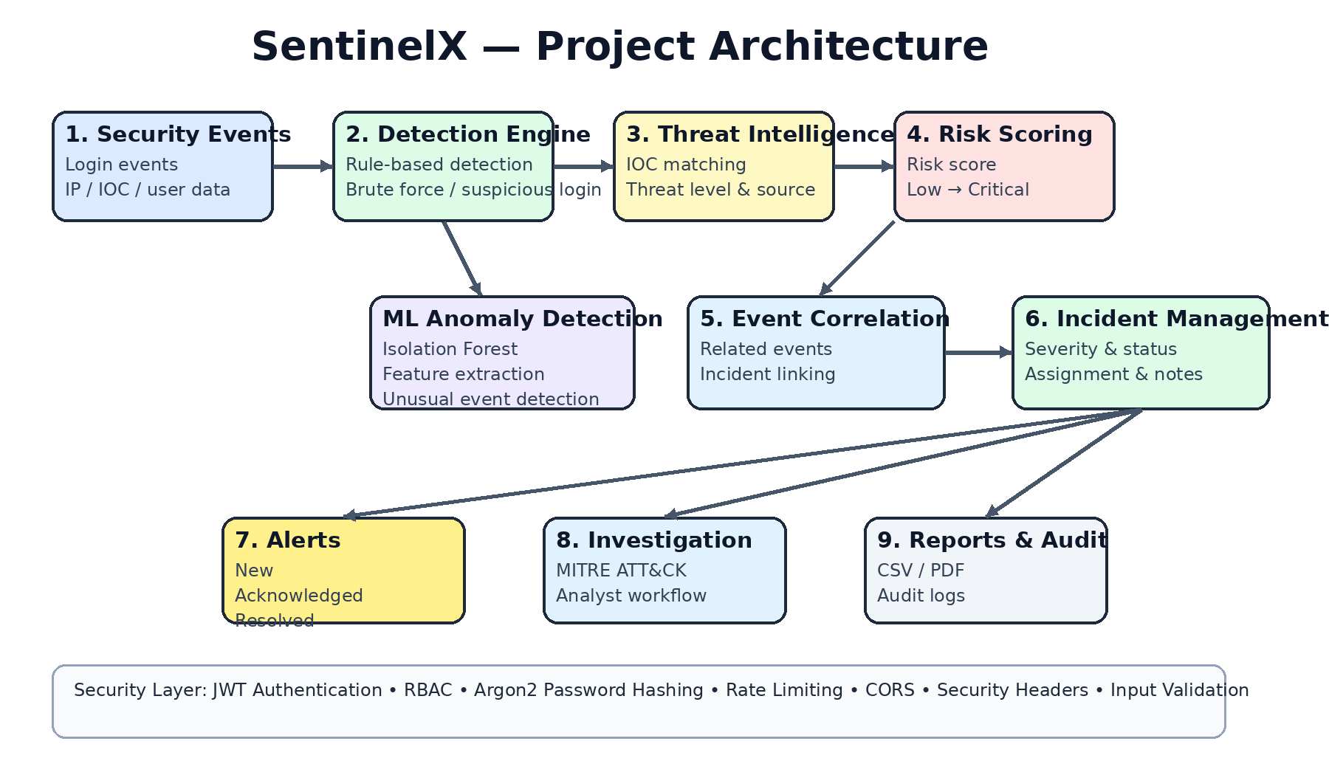
3. Project Architecture

Slide 5
4. SentinelX Workflow
Security Event
Detection
Threat Intelligence
Risk Scoring
Event Correlation
Incident
Alert
Investigation
Resolution
Audit & Report

Slide 6
5. Major Features
Authentication & RBAC
JWT login, Argon2 hashing, Admin/Analyst roles
Detection Engine
Brute force, suspicious login, IOC matching
Risk Scoring
Low, Medium, High, Critical prioritization
Incident Management
Assignment, status, notes, related events
Alert Management
New, acknowledged, resolved alerts
Threat Intelligence
IOC type, value, source, threat level
ML Anomalies
Isolation Forest based anomaly detection
MITRE ATT&CK
Maps detections to attacker techniques
Reports & Audit
CSV/PDF reports and analyst activity logs

Slide 7
6. Machine Learning Anomaly Detection
Input
Security event characteristics
Model
Isolation Forest
Output
Normal or anomalous event
Features include severity, login status, source IP, IOC, username, message length, and event type characteristics.
Anomalies can be integrated into the incident and alert workflow.
ML complements rule-based detection instead of replacing it.

Slide 8
7. MITRE ATT&CK Integration
T1110 — Brute Force
Credential Access • Repeated failed login attempts
T1078 — Valid Accounts
Initial Access • Suspicious login behavior
MITRE ATT&CK gives analysts a common language for attacker behavior.
It connects detection rules to known adversary techniques.
Additional mappings can be added as the platform grows.

Slide 9
8. Security Controls
JWT authentication
Protection at the application/API layer.
Argon2 password hashing
Protection at the application/API layer.
Role-Based Access Control
Protection at the application/API layer.
API rate limiting
Protection at the application/API layer.
CORS configuration
Protection at the application/API layer.
Security headers
Protection at the application/API layer.
Input validation
Protection at the application/API layer.
Global error handling
Protection at the application/API layer.
Audit logging
Protection at the application/API layer.

Slide 10
9. Technology Stack
Backend
Python • FastAPI • SQLAlchemy • Pydantic
Frontend
HTML5 • CSS3 • JavaScript
Database
SQLite
Machine Learning
Scikit-learn • Isolation Forest
Security
JWT • Argon2 • RBAC • MITRE ATT&CK
Tools
Git • GitHub • Swagger/OpenAPI • VS Code

Slide 11
10. Demonstration Flow
1. Login to SentinelX as an authorized analyst.
2. Open the SOC Dashboard and view current security metrics.
3. Review Security Events and identify suspicious activity.
4. Open an Incident and inspect related events and MITRE mapping.
5. Review Alerts and update the investigation workflow.
6. Open ML Anomalies to review unusual events.
7. Generate CSV/PDF reports and review Audit Logs.

Slide 12
11. Project Outcome
Centralized SOC-style monitoring interface
Automated rule-based and ML-assisted detection
Risk-based incident prioritization
Connected incident → alert → investigation workflow
MITRE ATT&CK context for detected behaviors
Reports and auditability for security operations
Core Platform
Completed
Security Modules
Integrated
GitHub
Project repository maintained

Slide 13
12. Future Enhancements
Real-time log streaming and SIEM integrations
Email/SMS or real-time alert notifications
More advanced ML models and behavioral analytics
Automated response and containment
Cloud deployment and Docker support
PostgreSQL production database
Expanded MITRE ATT&CK coverage
Advanced event correlation rules

Slide 14
Conclusion
SentinelX provides an end-to-end SOC monitoring and incident response workflow.
It combines detection, intelligence, ML, risk scoring, investigation, and reporting.
The platform helps analysts identify and prioritize security threats efficiently.

Slide 15
Thank You
Questions & Discussion

